Slide 1
Create tiled map using Global map
Taro Matsuzawa
Georepublic
https://github.com/smellman/creating_tiles_with_global_map_support_files

Slide 2
Self-Introduction
Senior Developer of Georepublic
Programming: Python, Ruby, JavaScript, Java, and others
Computer skill: UNIX and Linux, Networking(L1 to L7), Virtual Machine (VirtualBox, KVM, Docker)
GIS skill: Data processing, Tile
Computer community:
OSGeo.JP
OpenStreetMap Foundation Japan
Japan Unix Society
Mozilla community in Japan
Contact: taro@georepublic.co.jp or @smellman

Slide 3
Topics:
Introduction of the tile technology
Introduction of software and global map
Vector Tiles
Create Vector Tiles from vector files
Styling Vector Tiles
Create Raster Tiles from Vector Tiles and style
Raster Tiles
Create Raster Tiles from a raster file
Hosting

Slide 4
Introduction of the tile technology

Slide 5
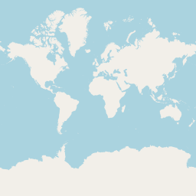
Tile technology
Provide map images or data over the internet.
Map images are separated as tile.
Zoom Level 0 = World
Each zoom level doubles in the dimensions.
Too many tiles use “Web Mercator projection”.
Structure of tile is useful to web.
Scroll, zoom up/down with AJAX request.
Tile become known for Google Maps.
Tile has existed from the late 1990s.
https://a.tile.openstreetmap.org/0/0/0.png

Slide 6
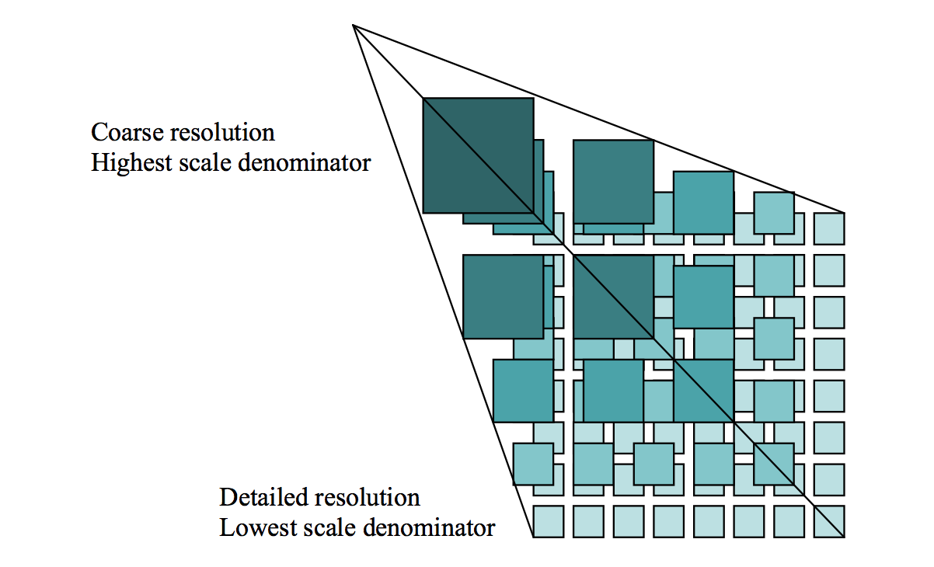
Zoom
Zoom level 0 : 1 file
Zoom level 1 : 2 x 2 = 4 files
Zoom level 2 : 4 x 4 = 16 files
…
Zoom level 18 262,144 x 262,144 = 68,719,476,736 files

Slide 7
Request
Many service use REST API (GET).
https://…/Z/X/Y.Format
Z = Zoom Level
X = X coordinate
Y = Y coordinate
Format
Raster image format (png, jpg, webp)
Vector data format (pbf, mvt)

Slide 8
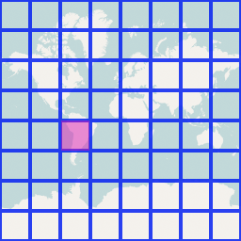
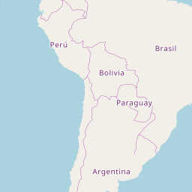
Request example
http://a.tile.openstreetmap.org/3/2/4.png
Zoom=3, X=2, Y=4, format=PNG
X and Y coordinates start with 0.

Slide 9
Web Mercator
Cut off coverage at 85.051129° north and south.
EPSG:3857
Famous as “OpenLayers:900913” (Google)
85.051129°
-85.051129°

Slide 10
Specification
Two tile service specifications
Tile Map Service (TMS)
Web Map Tile Service (WMTS)
TMS is simple than WMTS.
TMS’s X Y coordinate is started from bottom left.
Same as Cartesian coordinate system.
WMTS‘s X Y coordinate is started from top left.
Same as Coordinate system for 2D computer graphics.

Slide 11
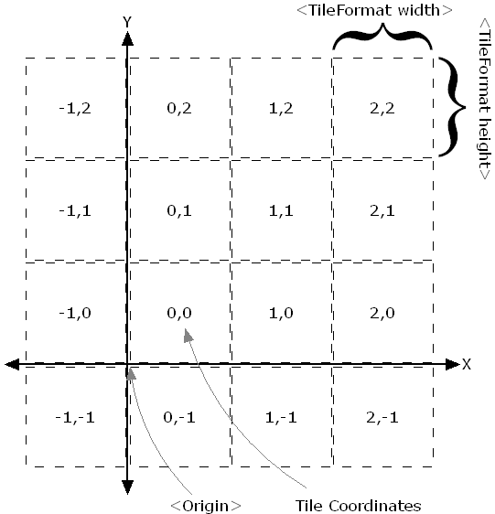
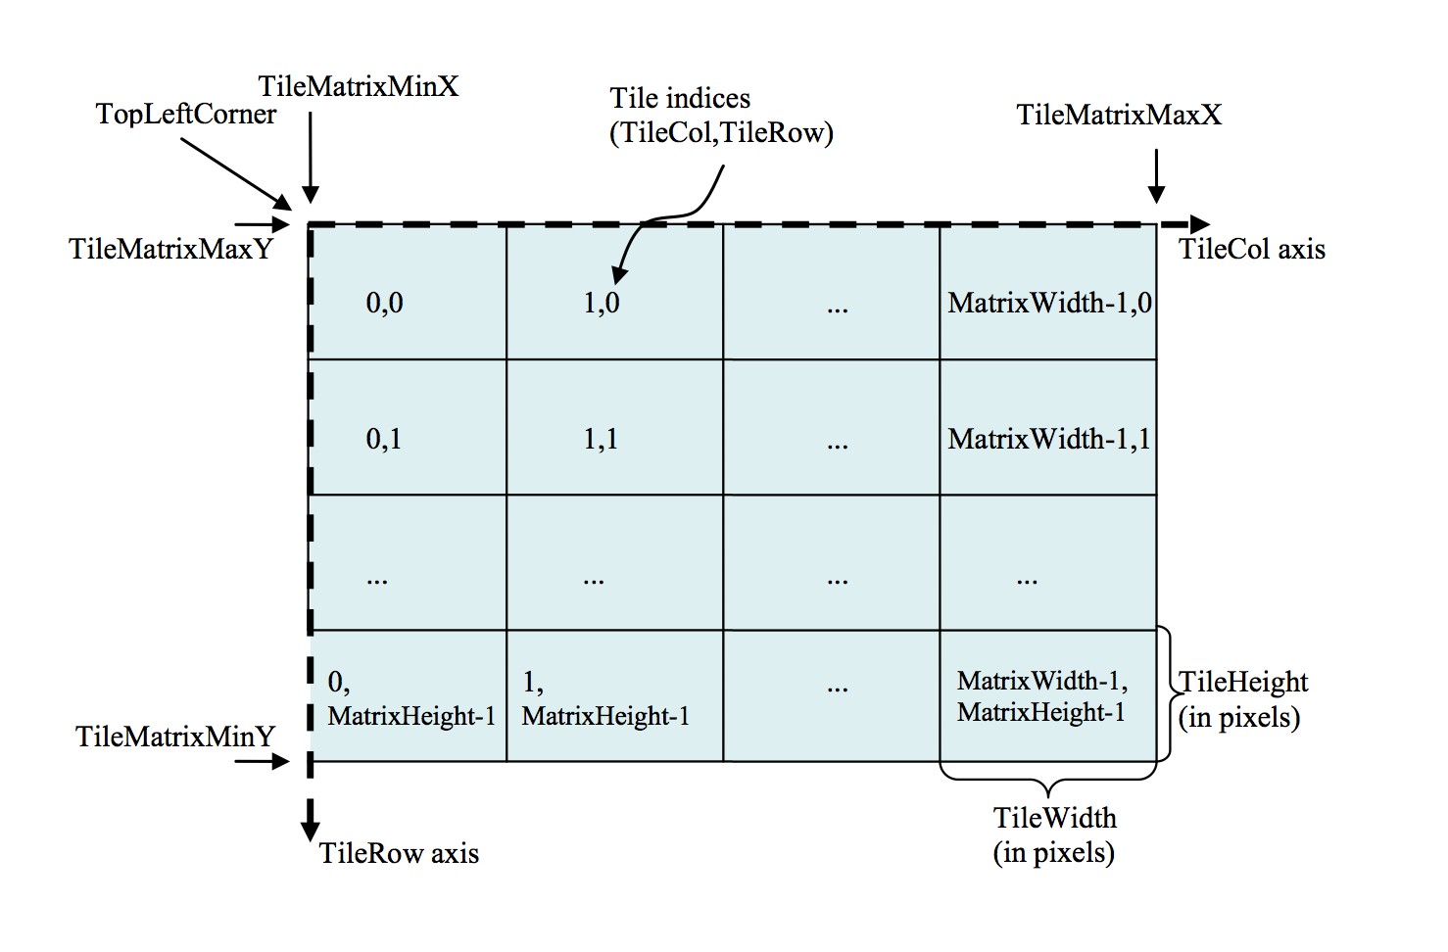
Difference between TMS and WMTS
TMS
WMTS

Slide 12
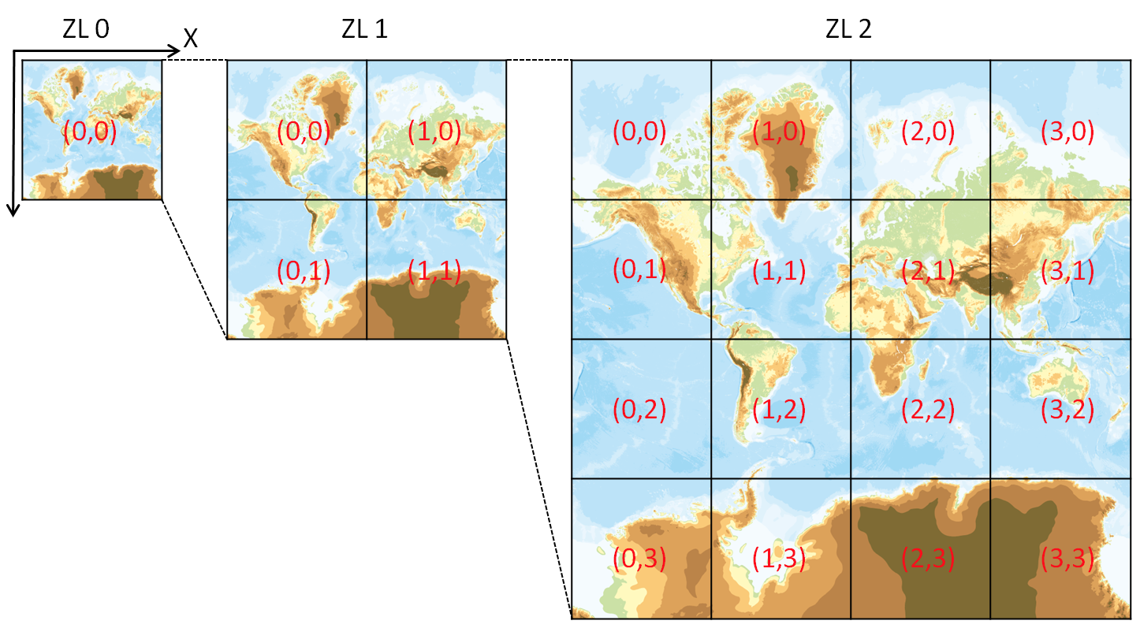
The Y coordinate flipped
OpenStreetMap use TMS like protocol but The Y coordinates are numbered from top left.
If take no thought of meta data, Y coordinate flipped TMS equals WMTS.
GSI Map use this rule too.
OpenStreetMap call “Slippy Map”
We call zxy tile
{z}/{x}/{y}.png
Also call xyz tile

Slide 13
ZXY Tile
De facto standard of tile.
Web Mercator
Y coordinate flipped TMS
Provide REST API
{z}/{x}/{y}.{format}
Anyone provide “Specification”
Too many libraries supports ZXY Tile.

Slide 14
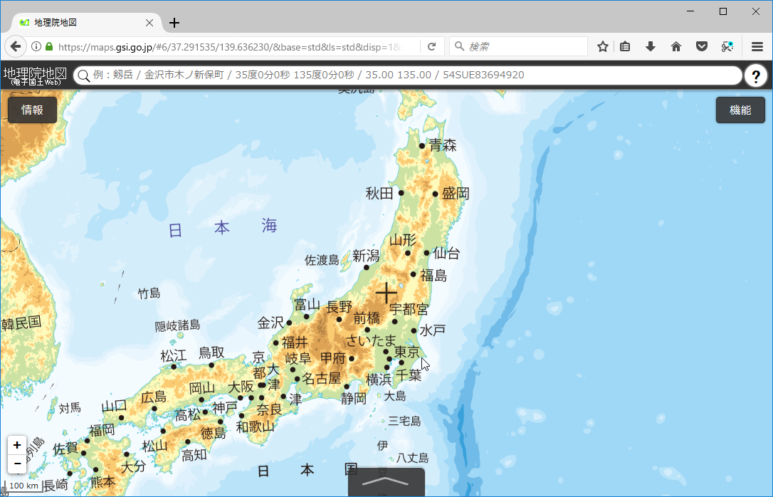
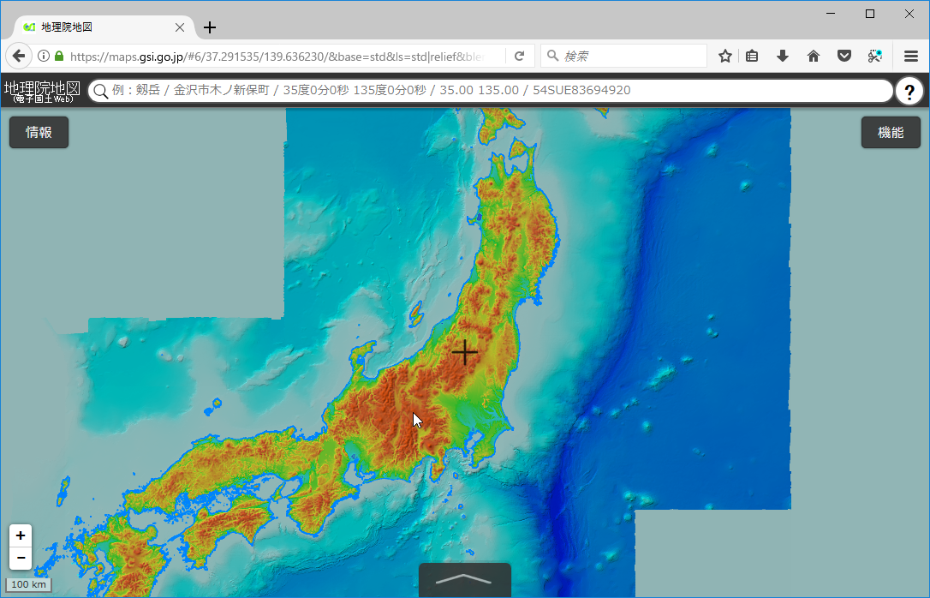
Raster tile
Provides “rendered image”.
The image doesn’t have ”data”.
Focus to visualization.
Enable to scroll and zoom up/down.
GSI provides tile of “digital elevation model” as PNG format.
The elevation value obtainable by calculating with RGB values.

Slide 15
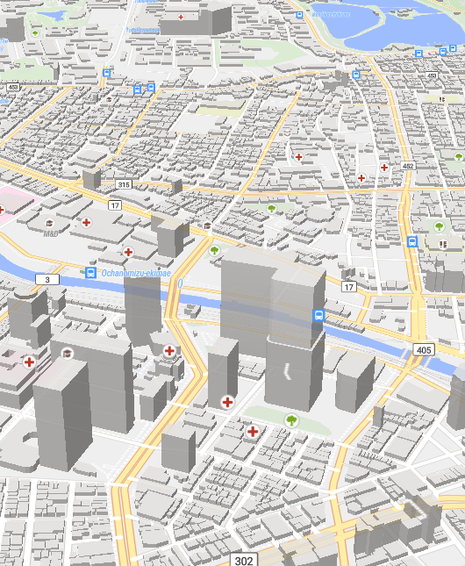
Vector Tile
Provides “Vector data”.
Each tile contains “Vector data”
The tile like a data container.
Vector tile doesn’t have style.
Client render image with style settings.
Easy to rotation and bearing.
Supports 3D view.
Also vector tile use only provide data.
Programmable
Client can modify styles.

Slide 16
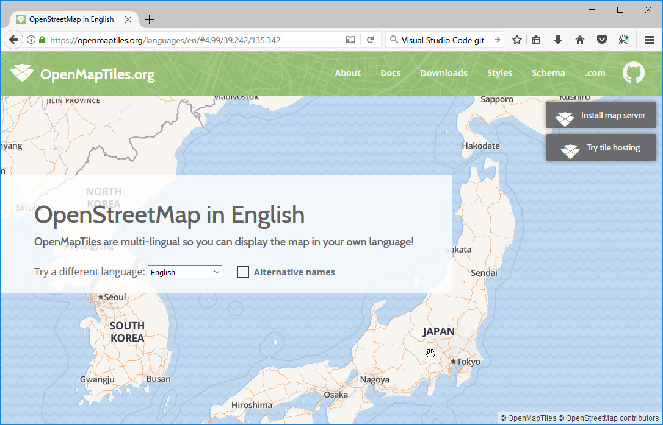

Vector Tile example – Multilingual
https://openmaptiles.org/languages/

Slide 17
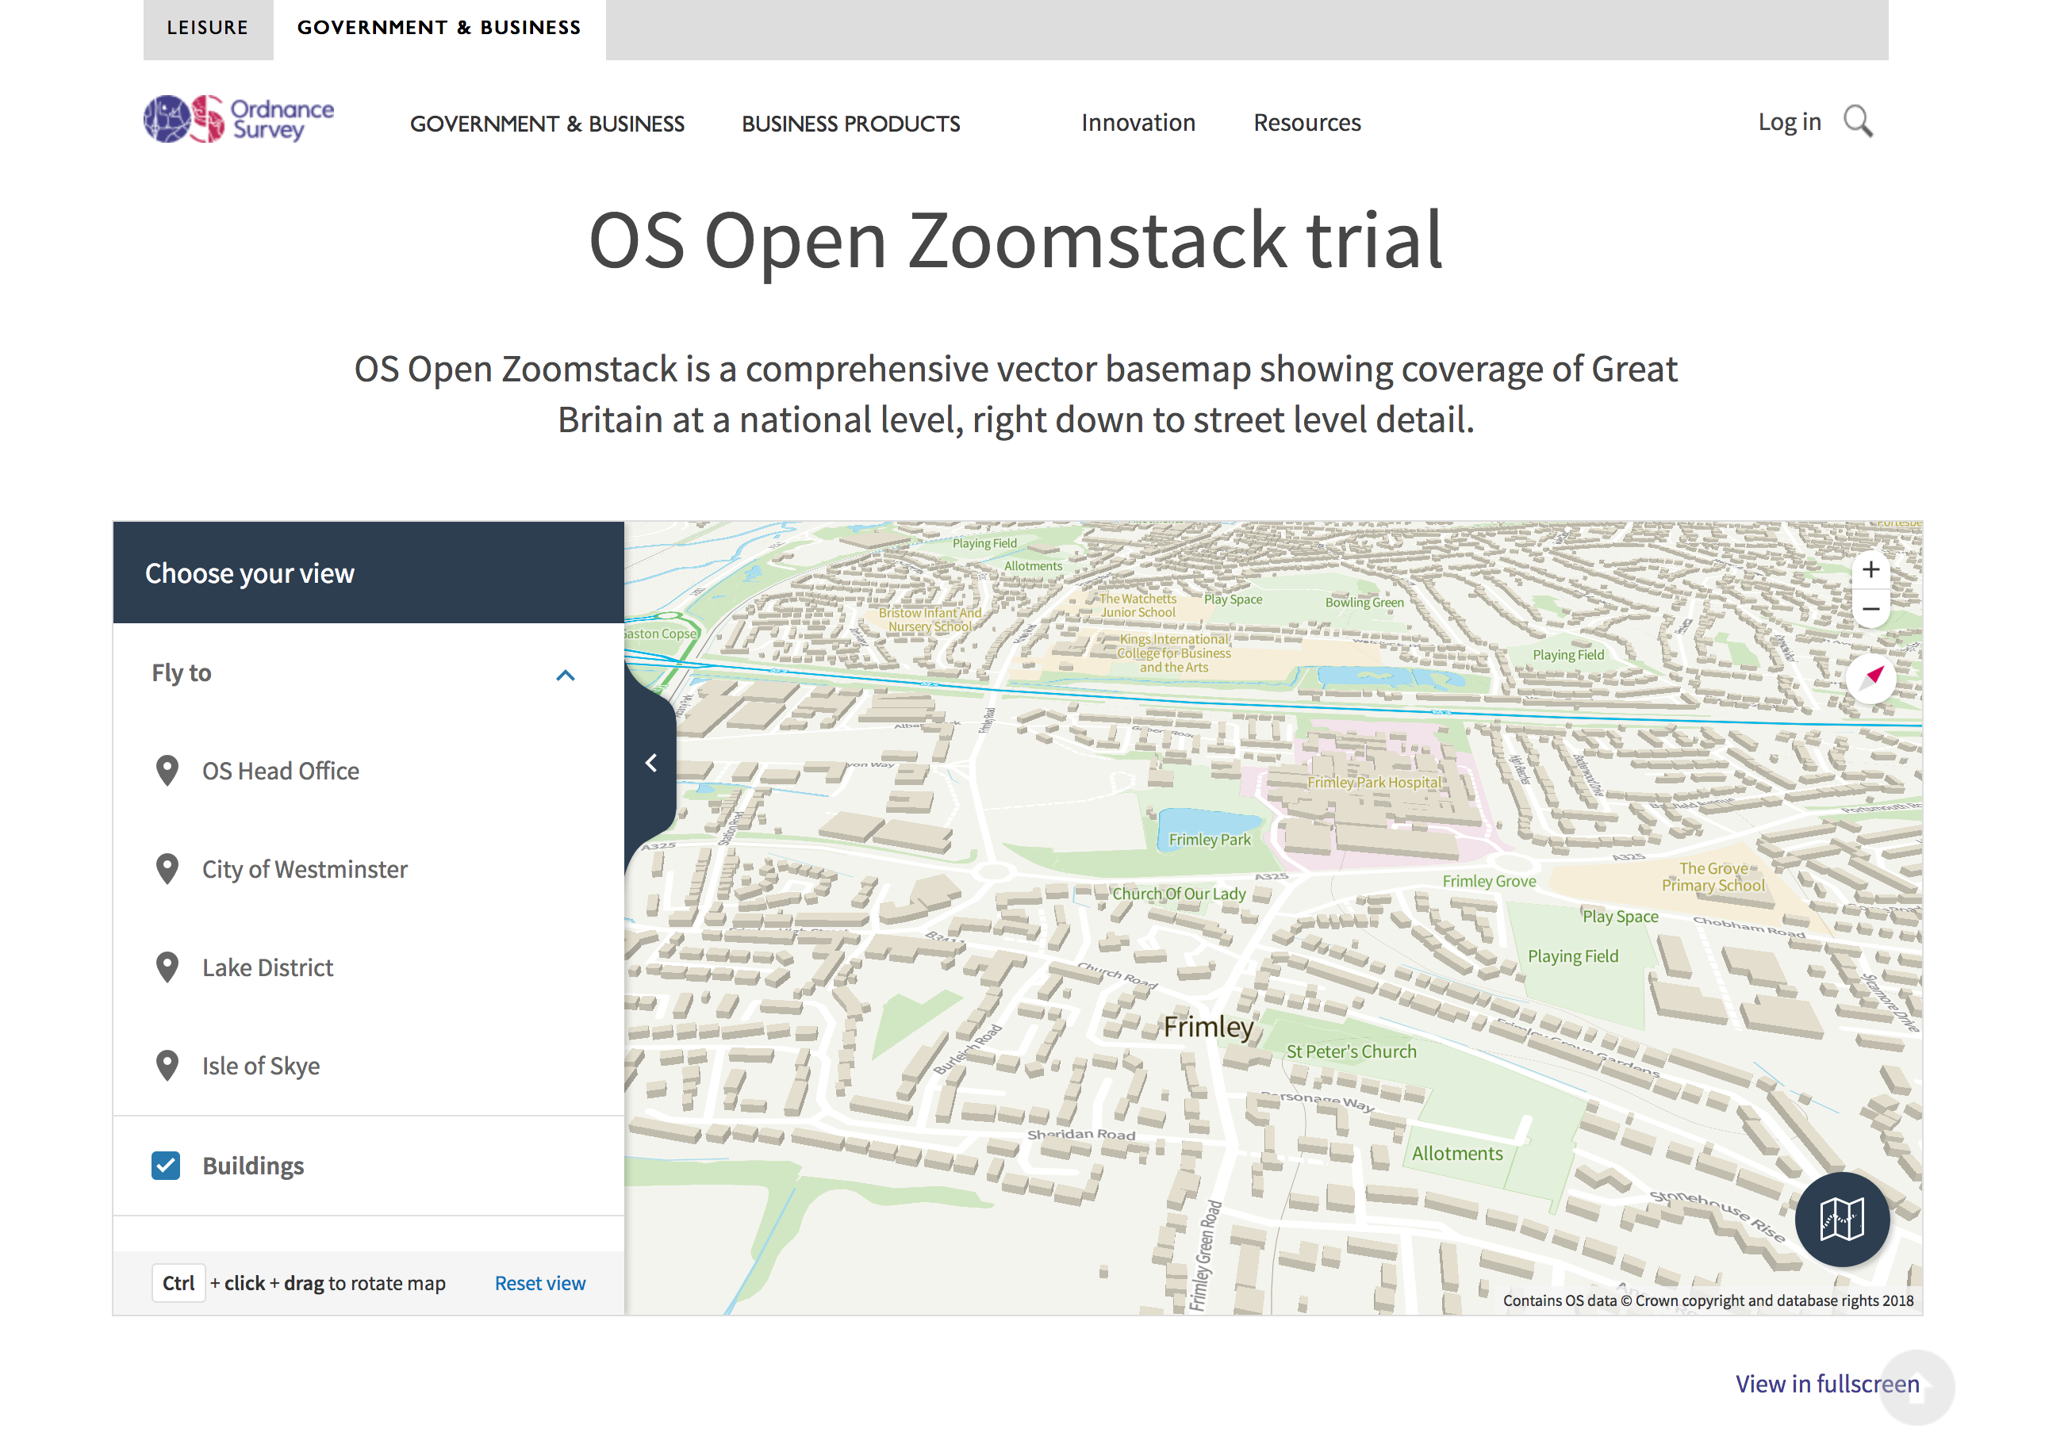
Vector Tile example – Ordnance Survey
https://www.ordnancesurvey.co.uk/business-and-government/products/os-open-zoomstack.html

Slide 18
Mapbox Vector Tile
Vector Tile specification by Mapbox Inc.
De facto standard of Vector Tile in current.
Specification
A tile encoded by Google’s Protocol Buffer format.
Designed with Web Mercator.
Supports Layers and Features.

Slide 19

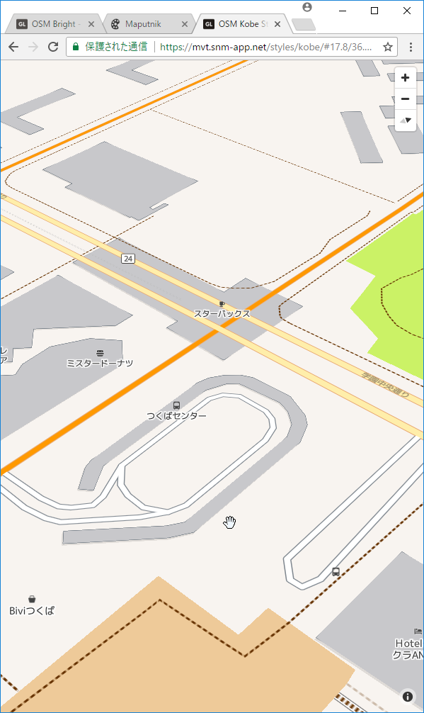
Mapbox GL ecosystem and Style Specification
Mapbox GL ecosystem
Mapbox provides Mapbox GL JS(Web), Mapbox GL Native(Smartphone and Desktop application) and too many convert tools.
Mapbox provides specification of styling.
https://www.mapbox.com/mapbox-gl-js/style-spec/
Tiles
Style
Client render in display
Mapbox GL

Slide 20
tileserver-gl & Maputnik
Mapbox provides Mapbox Vector Tile and Style editor as commercial service.
tileserver-gl is OSS software to provide Mapbox Vector Tile and style(includes fonts and sprite image)
It allows raster image hosting with server side rendering.
Maputnik is OSS Mapbox Style editor.
It allows to design with GUI.
Also, you can make the style with text editor.

Slide 21
Client
Platform | Library | Raster Tile | Mapbox Vector Tile
Javascript | Leaflet | OK | Plugin
 | OpenLayers 4 | OK | OK
 | Mapbox GL JS | OK | OK (*1)
 | Tangram (*2) | OK | OK
Android | Mapbox GL Native | OK | OK
 | Google Maps SDK | OK | NG
iOS | Mapbox GL Native | OK | OK
 | Mapkit | OK | NG
*1: Android webview is supported but buggy.
*2: Tangram will be duplicate

Slide 22
Introduction of software and global map

Slide 23
Requirements
Supported OS in this seminar
Windows 10 Pro with Creators update
Use Docker for Windows
Ubuntu 18.04
Hardware
4GB memory
Windows laptop requires 8GB memory
Docker requires to allocate 2GB memory but too many laptop memory shared with Video-RAM.

Slide 24
Software
Processing
QGIS or GDAL/OGR
tippecanoe
Hosting server
tileserver-gl
Design
Maputnik

Slide 25
Global map - introduction
Digital geographic information
Provided by International Steering Committee for Global Mapping (ISCGM)
Composed of 8 Data Sets
Vector Data (Transportation, Boundaries, Drainage, Population Centres)
Raster Data (Elevation, Vegetation, Land Cover, Land Use)
Free for non-commercial use.

Slide 26
Global map - archives
Archives and website were moved into github by GSI.
https://github.com/globalmaps
https://globalmaps.github.io/
Old website was closed
Some countries provides global map archives at the national site.
All links: https://github.com/globalmaps/projectmanagement/blob/master/REPOS.md
Some links are dead now.

Slide 27
Global map - formats
Vector data provide as Shapefile.
It was provide as Geography Markup Language (GML) format.
Raster data provide as GeoTiff file.
It was provide as Band interleaved by line (BIL) format.

Slide 28
Global map - versions
The data meaning are different between versions.
Example:
gmlk10 https://github.com/globalmaps/gmlk10
Global map version 1.x in Sri-Lanka.
gmlk20 https://github.com/globalmaps/gmlk20
Global map version 2.x in Sri-Lanka.
You can download all specifications:
https://github.com/globalmaps/specifications

Slide 29



Vector Processing 1
Shapefile
GeoJSON
Mapbox Vector Tile
1. Convert Shapefiles to GeoJSON files using QGIS or ogr2ogr.
2. Generate Mapbox Vector tile from GeoJSON files using tippecaneo.

Slide 30

Vector Processing 2
Mapbox Vector Tile
3. Create server in localhost.
tileserver-gl
4. Making custom style and upload.
Check design
maputnik

Slide 31




Raster Processing
1. Open in QGIS 2. Enable to transparent. 3. Output TMS tiles.
4. Convert TMS tiles to zxy tiles.

Slide 32
Create vector tile from vector file

Slide 33
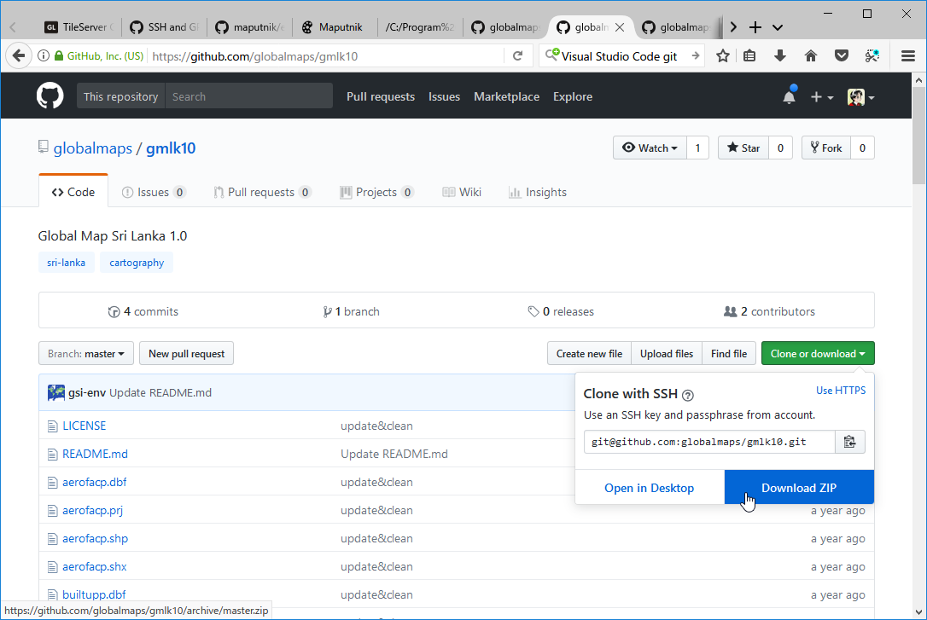
Download Sri Lanka data
Open following urls:
https://github.com/globalmaps/gmlk10
https://github.com/globalmaps/gmlk20
Click ”Clone or download” and click “Download ZIP”.
Extract ZIP file.

Slide 34
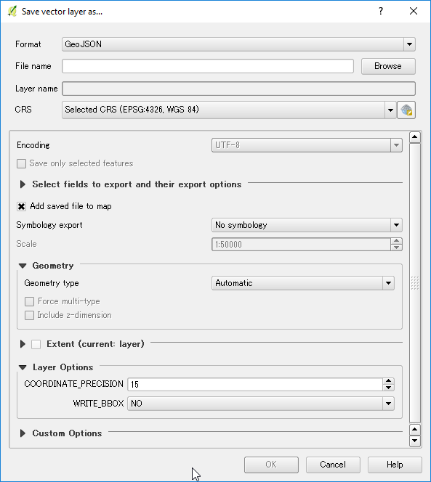
Convert Shapefiles to GeoJSON files
Start QGIS
Open Shapefile in gmlk20.
Right click the layer and select “Save as”.
Select ”GeoJSON” in Format.
Input File name and save.

Slide 35
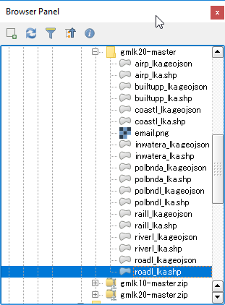
Result

Slide 36
tippecanoe
Tippecanoe is tool to build Mapbox Vector Tile from GeoJSON.
Tippecanoe is difficult to run in Windows.
You need build from source.
Mapbox provides “Dockerfile” to build ”Docker image”.

Slide 37
Docker
Docker is the famous technology as “software container platform”.
”software container” is focus to run “software”.
It is easy way to run Unix software in Windows.
Docker provides windows version.
Based on Hyper-V virtualization technology.
Windows 10 Pro can enable Hyper-V.

Slide 38
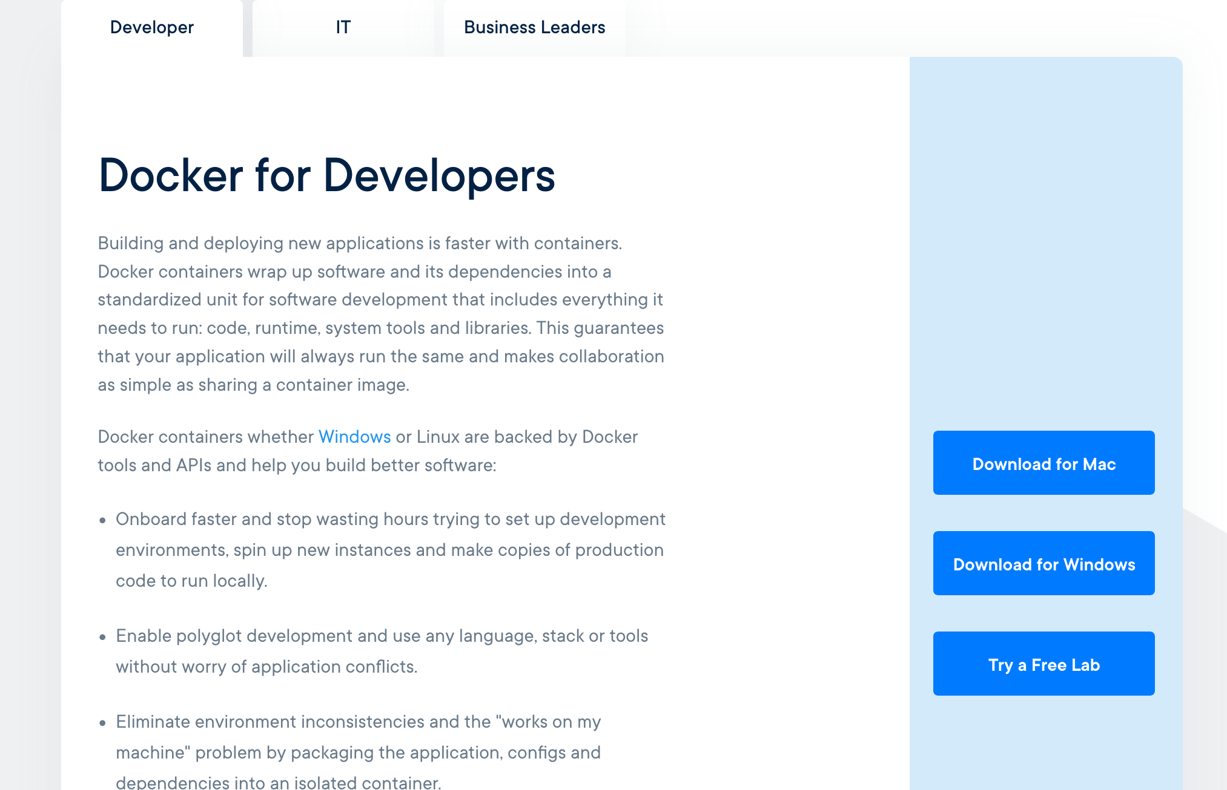
Install Docker for Windows
Enable Hyper-V
Go to https://www.docker.com/ and get installer from “Get Started” in header.
Install and reboot.

Slide 39
tippecanoe instraction
Download tippecanoe ZIP archive:
https://github.com/mapbox/tippecanoe
Extract it.
Execute PowerShell.
Change directory to extract directory.
Run following:
> docker build –t tippecanoe:latest .

Slide 40
Generate Mapbox Vector Tile from GeoJSON.
> cd PATH_TO/gmlk20_master
> docker run -it --rm -v ${PWD}:/data tippecanoe:latest tippecanoe -o /data/lka.mbtiles -L airp:/data/airp_lka.geojson -L builtupp:/data/builtupp_lka.geojson -L coastl:/data/coastl_lka.geojson -L inwatera:/data/inwatera_lka.geojson -L polbnda:/data/polbnda_lka.geojson -L polbndl:/data/polbndl_lka.geojson -L raill:/data/raill_lka.geojson -L riverl:/data/riverl_lka.geojson -L roadl:/data/roadl_lka.geojson
-v is volume option, PWD(print working directory) mount to /data
-o filename: output will be /data/lka.mbtiles (gmlk20_master/lka.mbtiles)
-L name:file.json: Specify layer names for individual files
“-it –rm –v” are docker options, -o and –L are tippecanoe options.

Slide 41
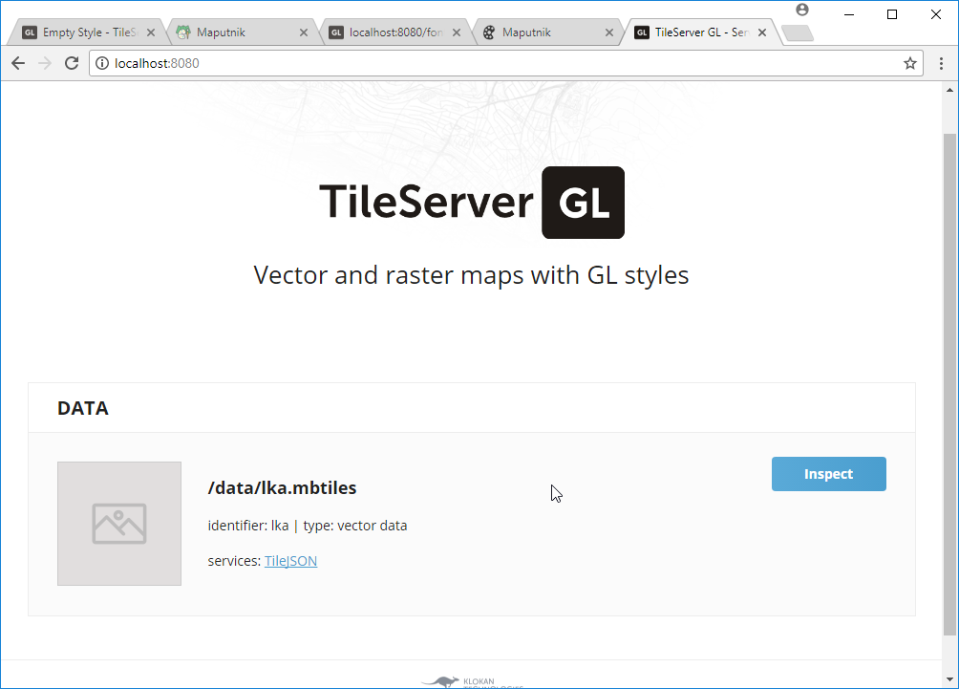
Run tileserver-gl
> cd PATH_TO/gmlk20_master
> docker run --rm -it -v ${PWD}:/data -p 8080:80 klokantech/tileserver-gl
Access to localhost:8080 in your browser.

Slide 42
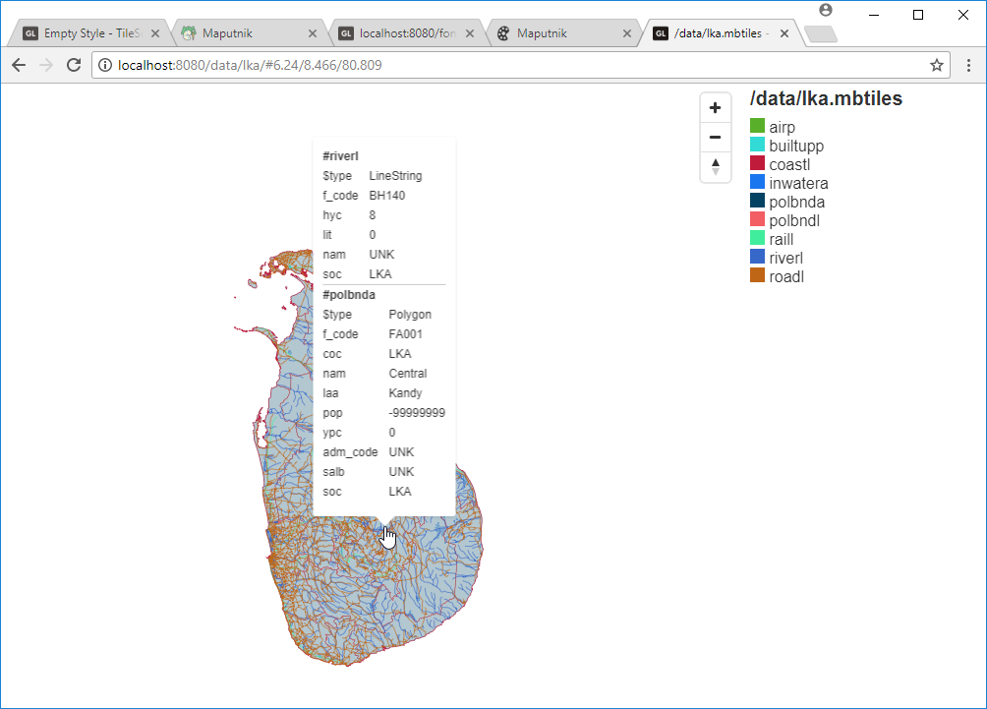
Check tile
Select inspect link, browser shows vector tile data.

Slide 43
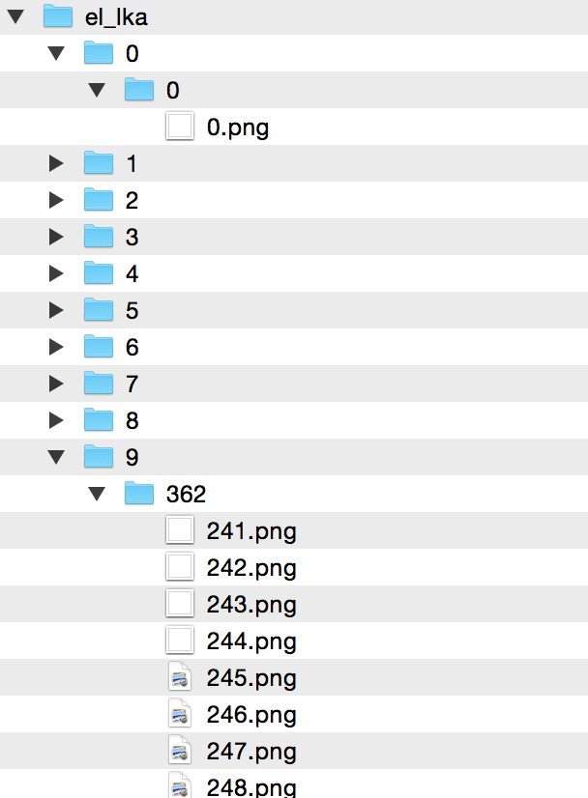
mbtiles
MBTiles is container of tile.
MBTiles is single file database (SQLite).
TMS schema (not zxy).
Ｘ | Ｙ | Ｚ | blob
0 | 0 | 0 | (binary)
… | … | … | …
241 | 362 | 9 | (binary)

Slide 44
Setup tileserver-gl
Create working directory “tileserver” and create “data” and “styles” directory under working directory.
Download ZIP archives from following urls and extract:
https://github.com/openmaptiles/fonts/tree/gh-pages
https://github.com/openmaptiles/osm-bright-gl-style/tree/gh-pages
Copy lka.mbtiles under “tileserver\data”

Slide 45
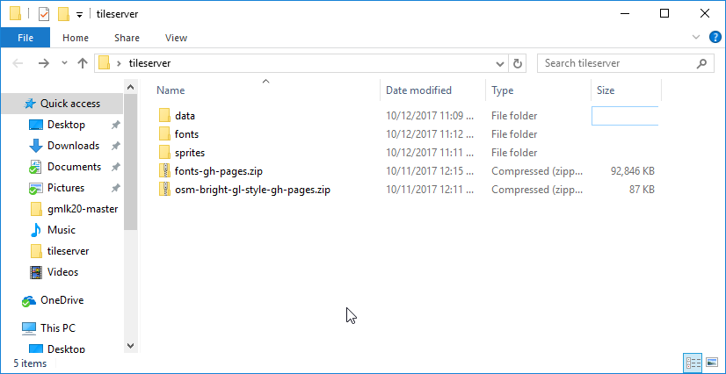
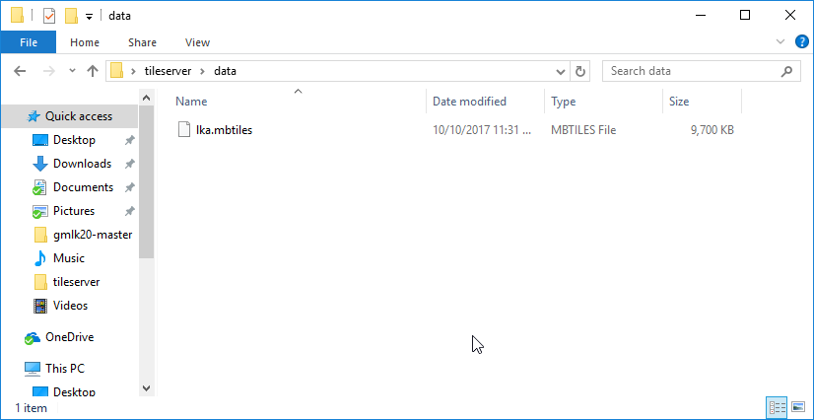

Slide 46
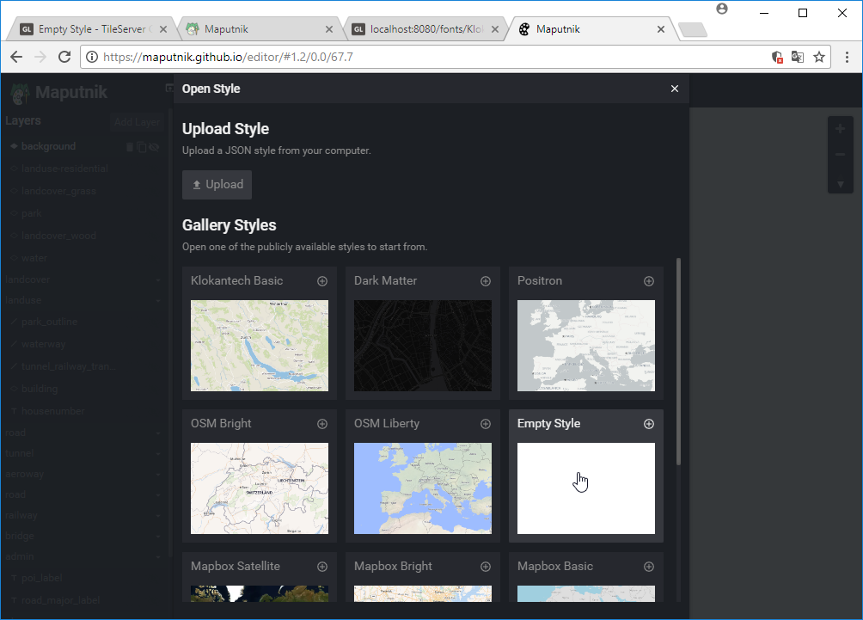
Create template style - 1
Access to https://maputnik.github.io/editor/
Select Open in top menu.
Select “Empty Style” from “Gallery Styles”.

Slide 47
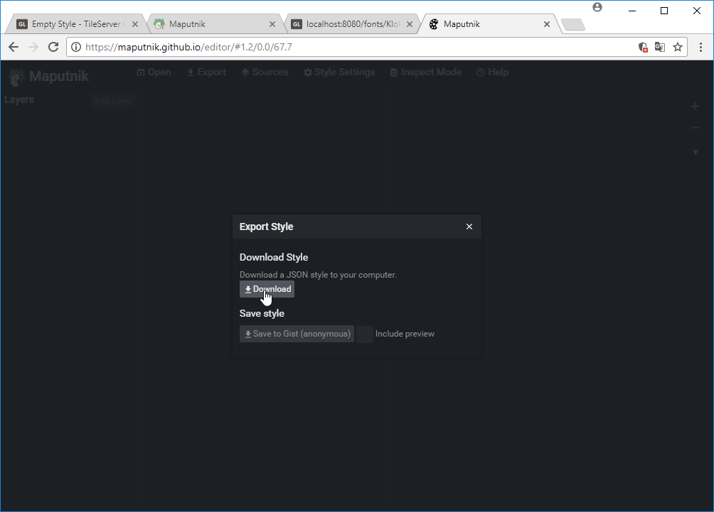
Create template style - 2
Select “Export” in top menu.
Click Download button in Export Style.

Slide 48
Create template style - 3
Create ”styles” directory under “tileserver” directory.
Copy downloaded style file (JSON file) to “styles” directory and rename to “globalmap.json”.
Open ”globalmap.json” file in Text Editor.
Modify “name”, “glyphs” and “sprites”.

Slide 49
Create template style - 4
--- globalmap-orig.json 2017-10-12 23:33:29.000000000 +0900
+++ globalmap.json 2017-10-12 23:35:06.000000000 +0900
@@ -1,6 +1,6 @@
{
"version": 8,
- "name": "Empty Style",
+ "name": "Global Map Style",
"metadata": {
"mapbox:autocomposite": false,
"mapbox:type": "template",
@@ -8,8 +8,8 @@
"openmaptiles:version": "3.x"
},
"sources": {},
- "glyphs": "https://demo.tileserver.org/fonts/{fontstack}/{range}.pbf",
+ "glyphs": "{fontstack}/{range}.pbf",
"layers": [],
- "sprites": "https://demo.tileserver.org/fonts/{fontstack}/{range}.pbf",
+ "sprite": "sprite",
"id": "yvib4c9ax"

Slide 50
Create config file for tileserver-gl.
tileserver-gl read “config.json” file in current directory.
{
"options": {
"paths": {
"root": "",
"fonts": "fonts",
"sprites": "sprites",
"styles": "styles",
"mbtiles": "data"
}
},
"styles": {
"globalmap": {
"style": "globalmap.json"
}
},
"data": {
"lka": {
"mbtiles": "lka.mbtiles"
}
}
}

Slide 51
Launch maputnik in local machine
Online version of maputnik can’t read any file from localhost because online version run in https schema but localhost will run http schema.
It known as insecure resource issue.
maputnik can run in localhost with docker.
> docker run --rm -it -p 8888:8888 maputnik/editor
Open localhost:8888 in Chrome browser.

Slide 52
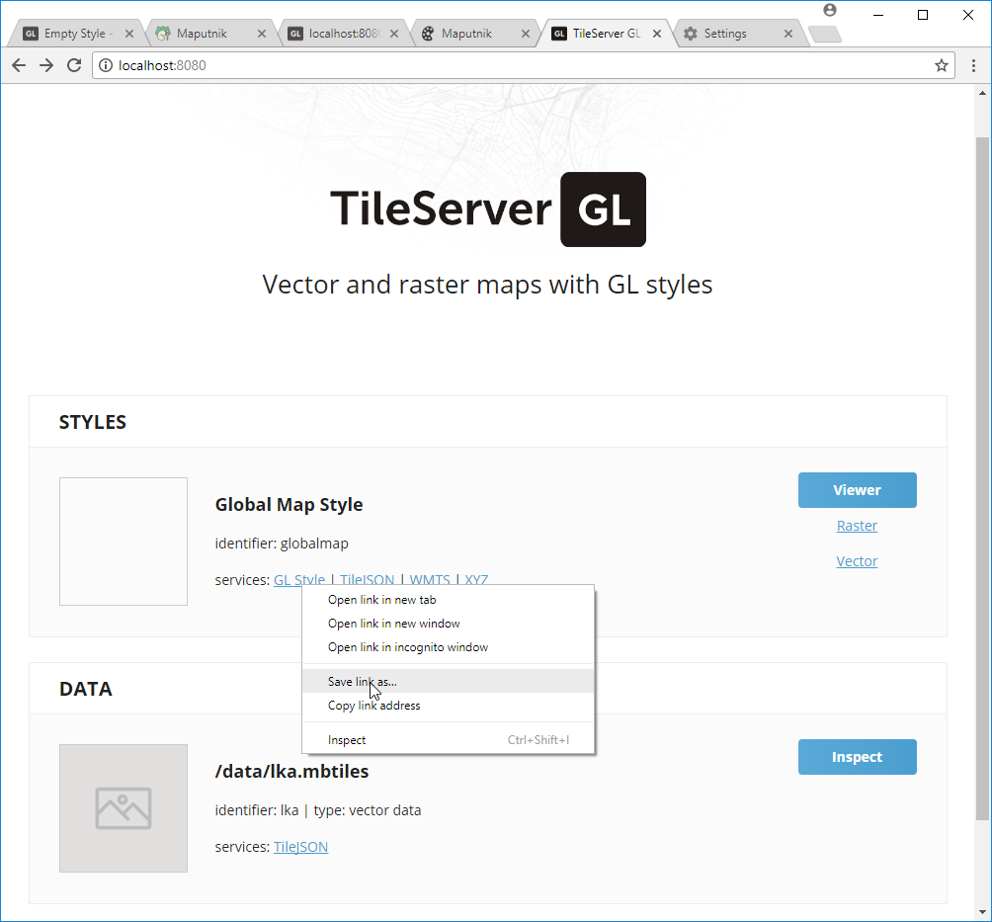
Setup maputnik - 1
Your need download “GL Style” from tileserver-gl top page.
The name will be “style.json”.

Slide 53
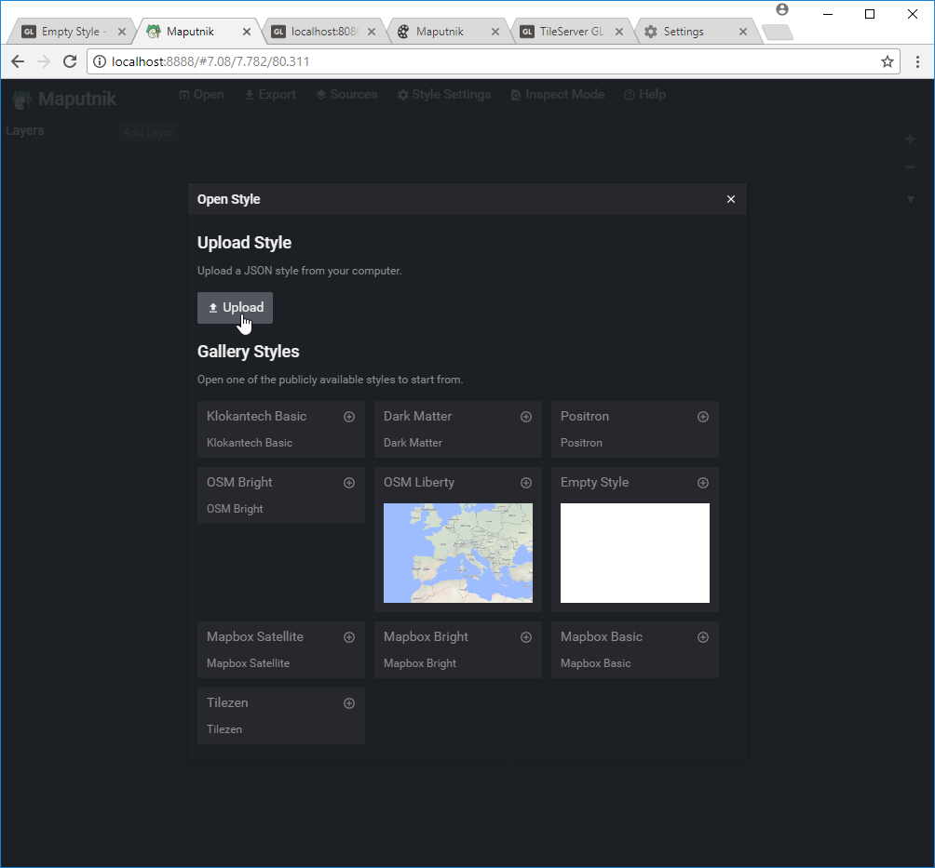
Setup maputnik - 2
Select “Open” in maputnik’s top menu.
Select “Upload” button and upload “style.json”.

Slide 54
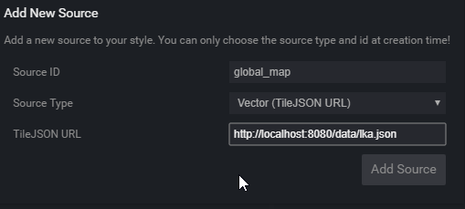
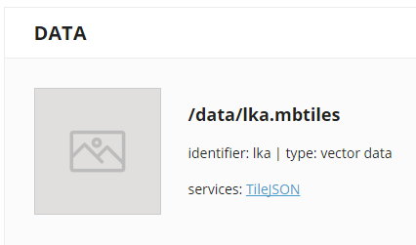
Setup maputnik - 3
Select “Sources” in maputnik’s top menu.
Fill “Add New Source” fields:
Source ID: global_map
Source Type: Vector (TileJSON URL)
TileJSON URL: http://localhost:8080/data/lka.json
Copy url from tileserver-gl top page.

Slide 55
Layers in Mapbox Style
Mapbox Style has 7 Layer Type.
Background
Fill
Line
Symbol
Raster
Circle
Draw circle image.
Fill Extrusion
Fill Extrusion will use 3D.
https://www.mapbox.com/mapbox-gl-js/style-spec/

Slide 56
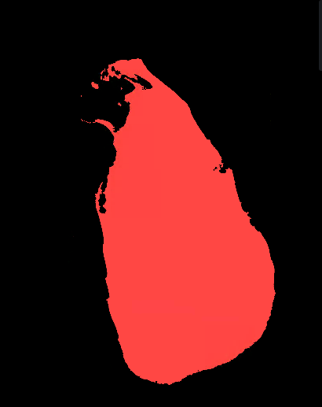
Layer - background
Fill all background with color or image pattern.
Background

Slide 57
Layer - Fill
Fill area with color or image pattern.
Fill

Slide 58
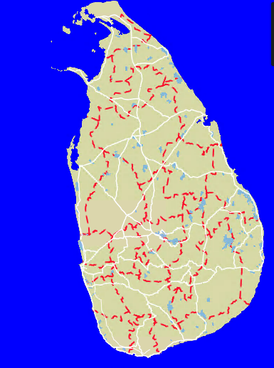
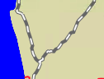
Layer - Line
Draw line with polyline features.
Normal line.
Dash-array.
Normal line + dash-array

Slide 59
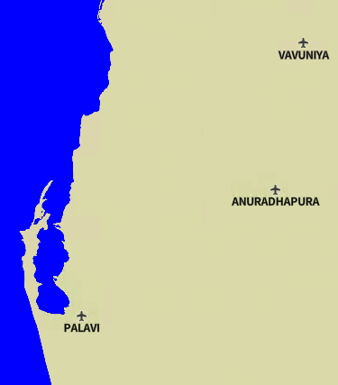
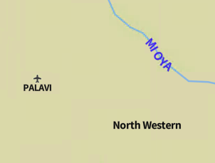
Layer - Symbol
Draw image and text.
Allow Point, Polygon and Polyline features.
Polyline
Polygon
Point

Slide 60
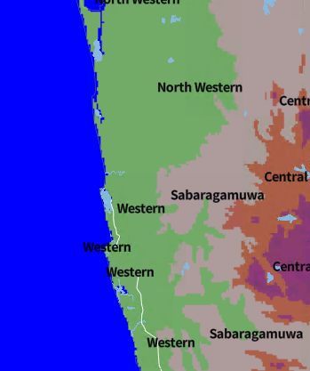
Layer - Raster
Draw raster tile image.
This image show elevation layer.

Slide 61
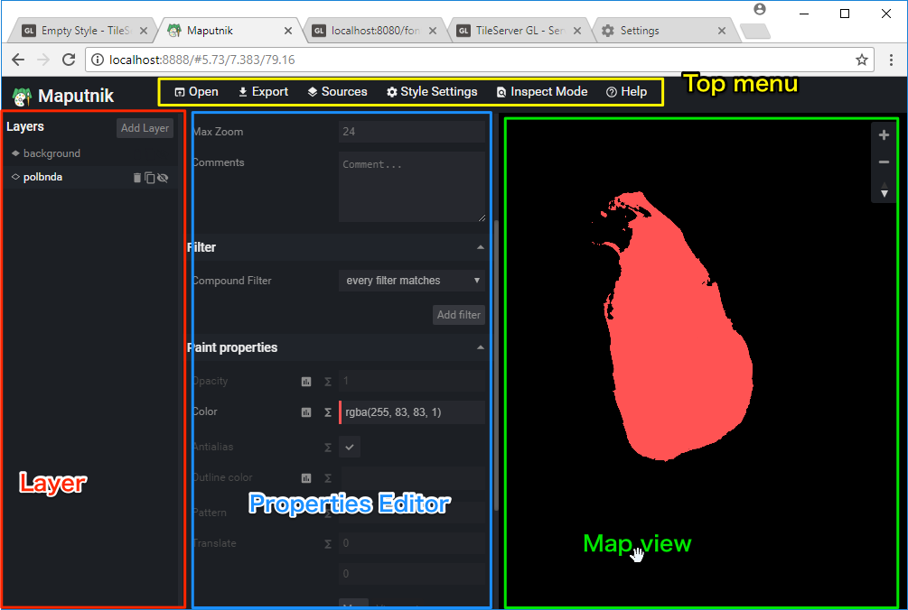
Maputnik UI

Slide 62
Maputnik workflow
Add Layer.
Set basic configuration in dialog.
Setup layer properties.
Min Zoom & Max Zoom
Filter
Layout Properties
Paint / Text / Icon properties
Sort layer
Save configuration.

Slide 63
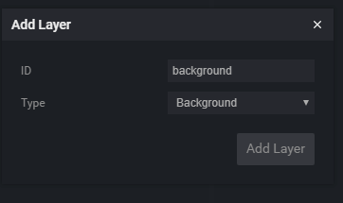
Add background layer
Click “Add Layer” button.
Change “Type” field to Background.
Background only need ID.
Set ID to ”background”.

Slide 64
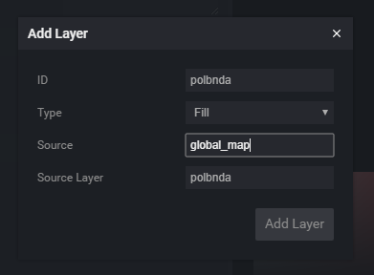
Add Fill Layer
Click “Add Layer” button.
Change “Type” to “Fill”.
Set fields:
ID: polbnda
Source: global_map
Source Layer: polbnda
Source = lka.mbtiles
Source Layer is defined by tippecanoe command line options.
-L polbnda:/data/polbnda_lka.geojson

Slide 65
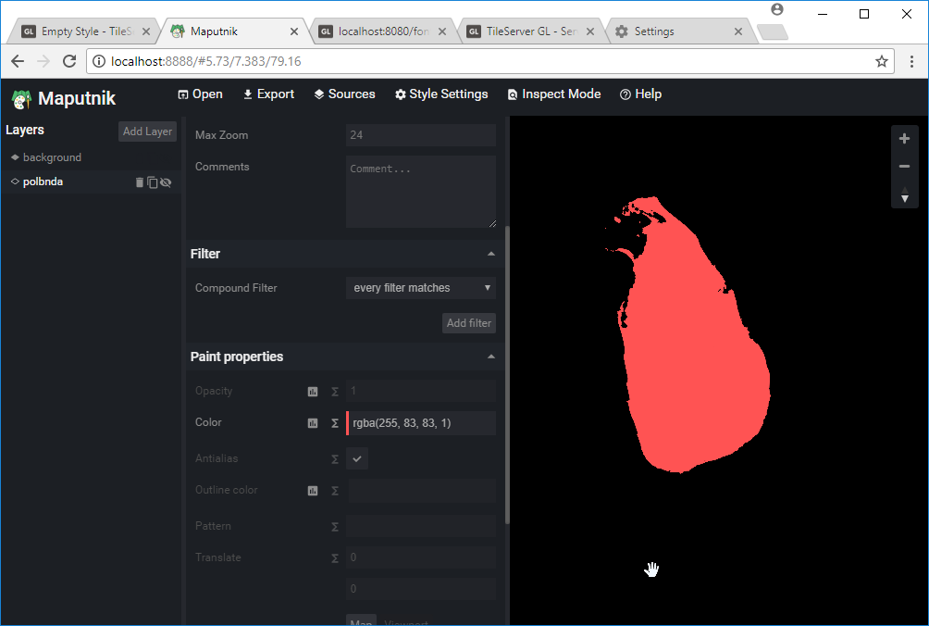
Change color in polbnda layer
Select ”polbnda” layer and change Color value in Paint properties.

Slide 66
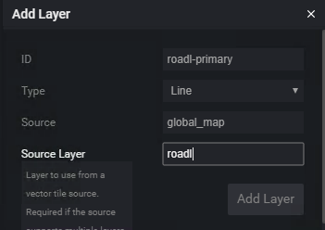
Add Line Layer
Click “Add Layer” button.
Change “Type” to “Line”.
Set fields:
ID: roadl-primary
Source: global_map
Source Layer: roadl
Source Layer is defined by tippecanoe command line options.
-L roadl:/data/roadl_lka.geojson

Slide 67
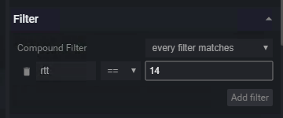
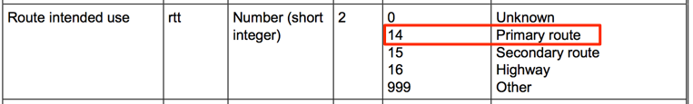
Setup Filter
“roadl” has “Route intended use” attribute.
Field name is “rtt”
“rtt” = 14 is primary route.
Select ”roadl-primary” layer and click “Add filter”.
Set filter “rtt == 14”.

Slide 68
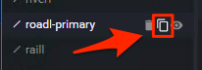
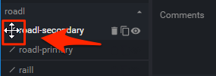
Copy Layer
Click ”copy button” in roadl-primary layer.
New layer “roadl-primary-copy” will created.
Change layer ID to “roadl-secondary”.
Modily filter to “rtt == 15”.
Drag down layer.

Slide 69
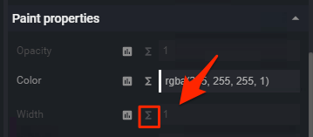
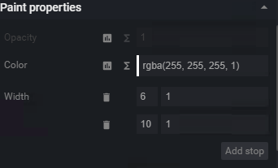
Setup Line properties
Set both colors to white.
Select zoom function button.

Slide 70
Zoom function
Zoom function is useful to smooth zoom.
Set Zoom 6 = 1 and Zoom 10 = 6, the value will increase between Zoom 6 and 10.
“base” property will use to control the rate witch the function output increases.
base = 1 will be increase linearly.
“base” property can’t edit in maputnik GUI but can edit in JSON editor.
https://www.mapbox.com/mapbox-gl-js/style-spec/#other-function

Slide 71
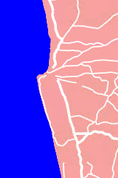
Setup Width function.
”roadl-primary”
Zoom 6 = 1
Zoom 12 = 6
“roadl-secondary”
Zoom 8 = 1
Zoom 12 = 4
Be careful about the editor check validation every time.

Slide 72
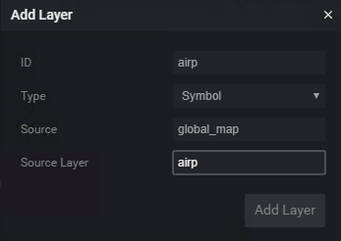
Add Symbol layer.
Click “Add Layer” button.
Change “Type” to “Symbol”.
Set fields:
ID: airp
Source: global_map
Source Layer: airp

Slide 73
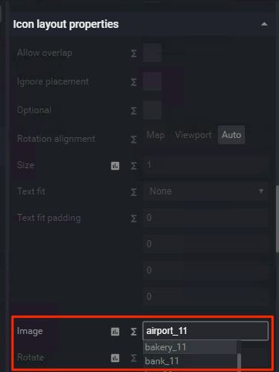

Setup Icon
Select “Image” property in Icon Layout property.
If ”Sprite URL” is setuped, image name enable to search.
Select “airport_11”.

Slide 74
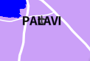
Setup Text - 1
Select “Field” property in Text layout properties.
It can use Feature properties using token like {field_name}.
airp’s nam property is name.
Set {nam} into Field property.
But result seem wrong.
Need to set “Offset”.

Slide 75
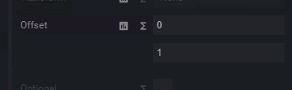


Setup Text - 2
Select ”Offset“ property.
This property has 2 value by default.
X and Y.
Set Y value to 1.
It seem OK and rotation is no problem too.

Slide 76

Deploy design.
When finished design, you need to download style into local.
Open downloaded design file and modify three lines.
sources/global_map/url to “mbtiles://{lka}”.
glyphs to “{fontstack}/{range}.pbf”
sprite to “sprite”
Overwrite globalmap.json in tileserver-gl.

Slide 77

Result

Slide 78
Create raster tile from vector tile and style
Tileserver-gl support raster tile output.
The output url will be
http://{server}/styles/{style identifier}/{z}/{x}/{y}.png
You can access from ”raster” in top menu.

Slide 79
Create raster tile from raster file

Slide 80
Making 4 tile set
Elevation
Land Use
Land Cover
Vegetation

Slide 81

Start QGIS and open
gmlk-10 contains All GeoTiff files in Sri-Lanka.

Slide 82

Add transparency into Elevation data
Double click el layer.
Select “Transparency”
Select Transparency band to None.
Add Transparenct pixel list
From 0, To 0, Percent 100.
Click OK.

Slide 83


Result

Slide 84

Save as GeoTiff image
Save new GeoTiff Image.
Select “Rendered image” in “Output mode”.
New image will have 4 band with alpha channel.

Slide 85


Create raster tile.
Open “Commander” in “Processing” menu.
Input gdal2 into commander.
Select gdalogr:gdal2tiles and input enter.

Slide 86

gdal2tiles dialog
It is gdal2tiles.py‘s GUI frontend.

Slide 87

Input parameter
Select saved geotiff layer.
Extract “Advanced parameter”.
Set “Resampling method” to “near”
Set “Zoom levels to render” to “0-11”.
Select your directory to output.
Ex: el_tms

Slide 88

Click Run

Slide 89
Convert TMS to zxy
Gdal2tiles output TMS structure tile.
You need to convert to zxy.
Download tms2xyz.py.
https://github.com/smellman/creating_tiles_with_global_map_support_files/tree/master/2014
Copy tms2xyz.py into created directory.
Open “OSGeo4W Shell” in Startup -> QGIS 2.x.
Change directory to output directory.
Run following:
python tms2xyz.py el_tms el

Slide 90
Note
Land Use, Land Cover and Vegetation doesn’t have “no value data” area.
If you make transparency, some data will be lost.

Slide 91
Hosting

Slide 92
Vector tile hosting
Vector tile hosting is easy because tileserver-gl can run too many linux hosts.
But Vector tile needs SSL access in internet.
Let‘s encrypt is useful to get free SSL/TLS Certificates.
https://letsencrypt.org/
Setup frontend server(Apache/nginx/etc) and connect from server with reverse proxy.

Slide 93
Raster tile hosting
If you use small number of data only, hosting as static image is better.
Apache / nginx / Amazon S3 / etc
Github’s gh-page is useful for free hosting.
Be careful about license.
If you use large number of data, be careful to hosting.
File system limitation: max number of files.
Ext4 on Linux: 4 billion files (specified at filesystem creation time)
File copy will slow.
Mbtiles is a solution to hosting large number of data.

Slide 94


Overview - nginx
Internet
Vector Tile
Reverse Proxy
Static contents
Raster Tile

Slide 95
Reverse proxy setting
In nginx, it is easy to setup.
location / {
proxy_set_header X-Forwarded-Proto https;
proxy_set_header X-Forwarded-For $proxy_add_x_forwarded_for;
proxy_set_header Host $http_host;
proxy_pass http://localhost:8080;
}

Slide 96
Raster tile hosting with tileserver-gl
Tileserver-gl can deliver raster tile but rendering will slow.
If you use this function, you need setup cache server.

Slide 97

The idea
Use varnish cache for raster rendering.
See my presentation at StateoftheMap 2017.
http://tiny.cc/vyvaoy
https://youtu.be/aoT3FY_CTQc?t=852

Slide 98
Other Topics: United Nations Vector Tile Toolkit
Hidenori Fujimura (@hfu) in United Nations tries to make vector tile easy to hosting.
https://github.com/hfu/hands-on-prod
https://github.com/hfu/hands-on-host
He will do workshop in FOSS4G ASIA about UN Vector Tile Toolkit.
I recommend to follow up UN Vector Tile Toolkit.

